Slide 1
Welcome
scaleup - nation

Slide 2
Verne Harnish
“Growth Guy”

Slide 3
12,000+ Members
6 Continents

Slide 4
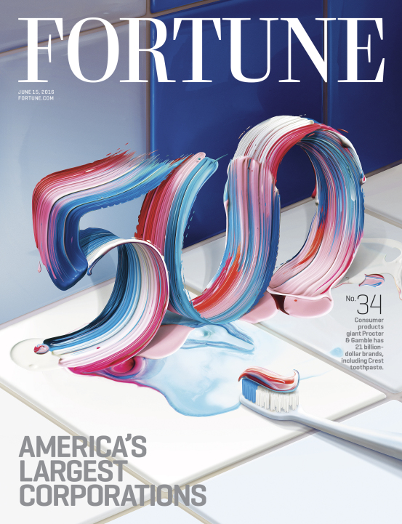
206 Coaching Partners
6 Continents
2000+ Active Clients
40,000+ Total

Slide 5
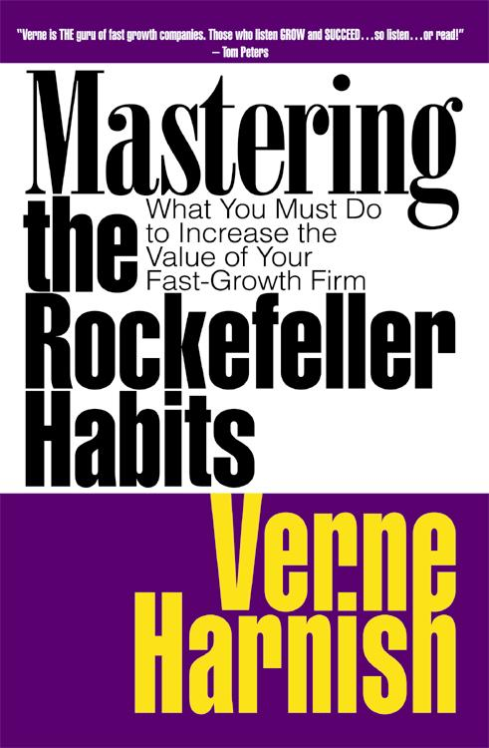
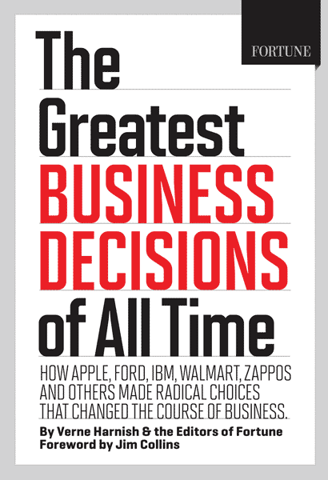

Slide 6
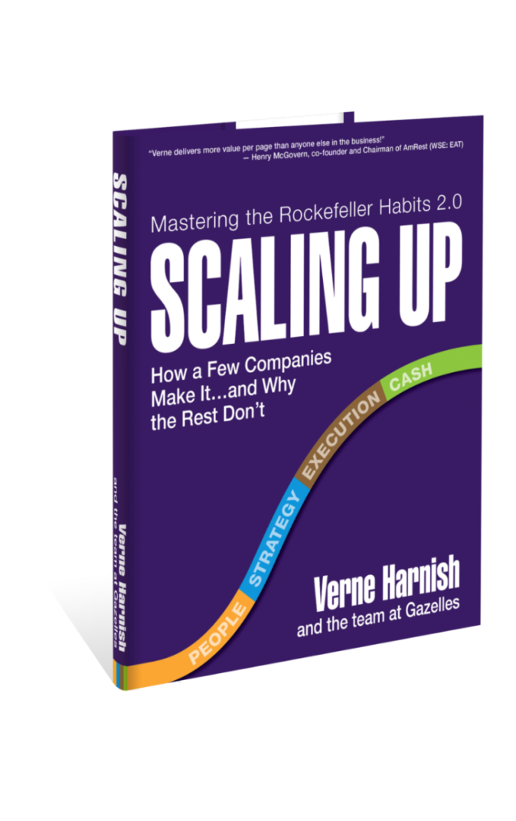

Slide 7
Verne Harnish
“Growth Guy”

Slide 8
“Many startup…few scaleup”

Slide 9
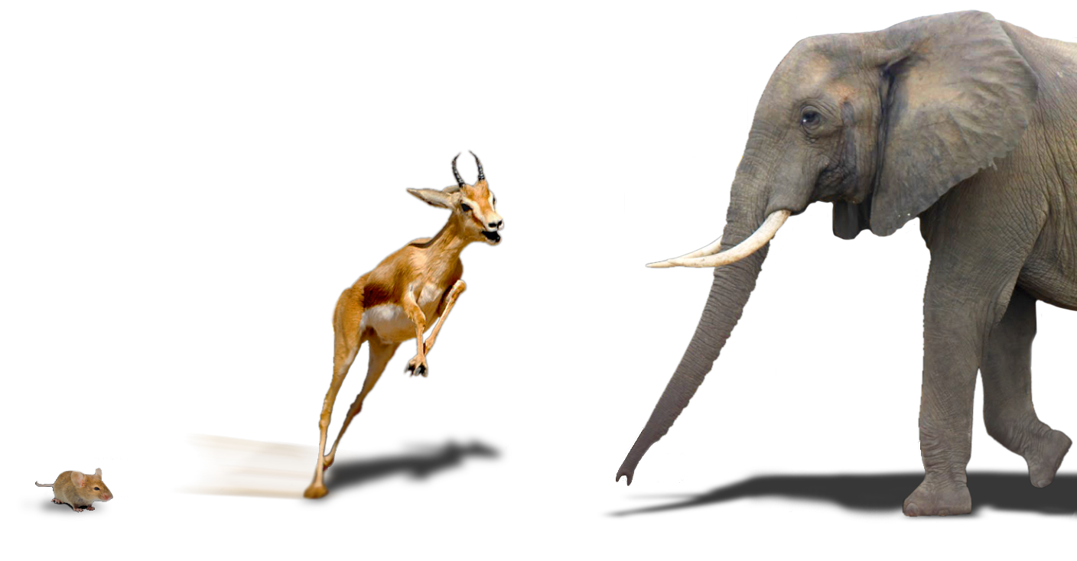
Life Cycle of Companies
Startup
Scaleup
Sc@%wup

Slide 10
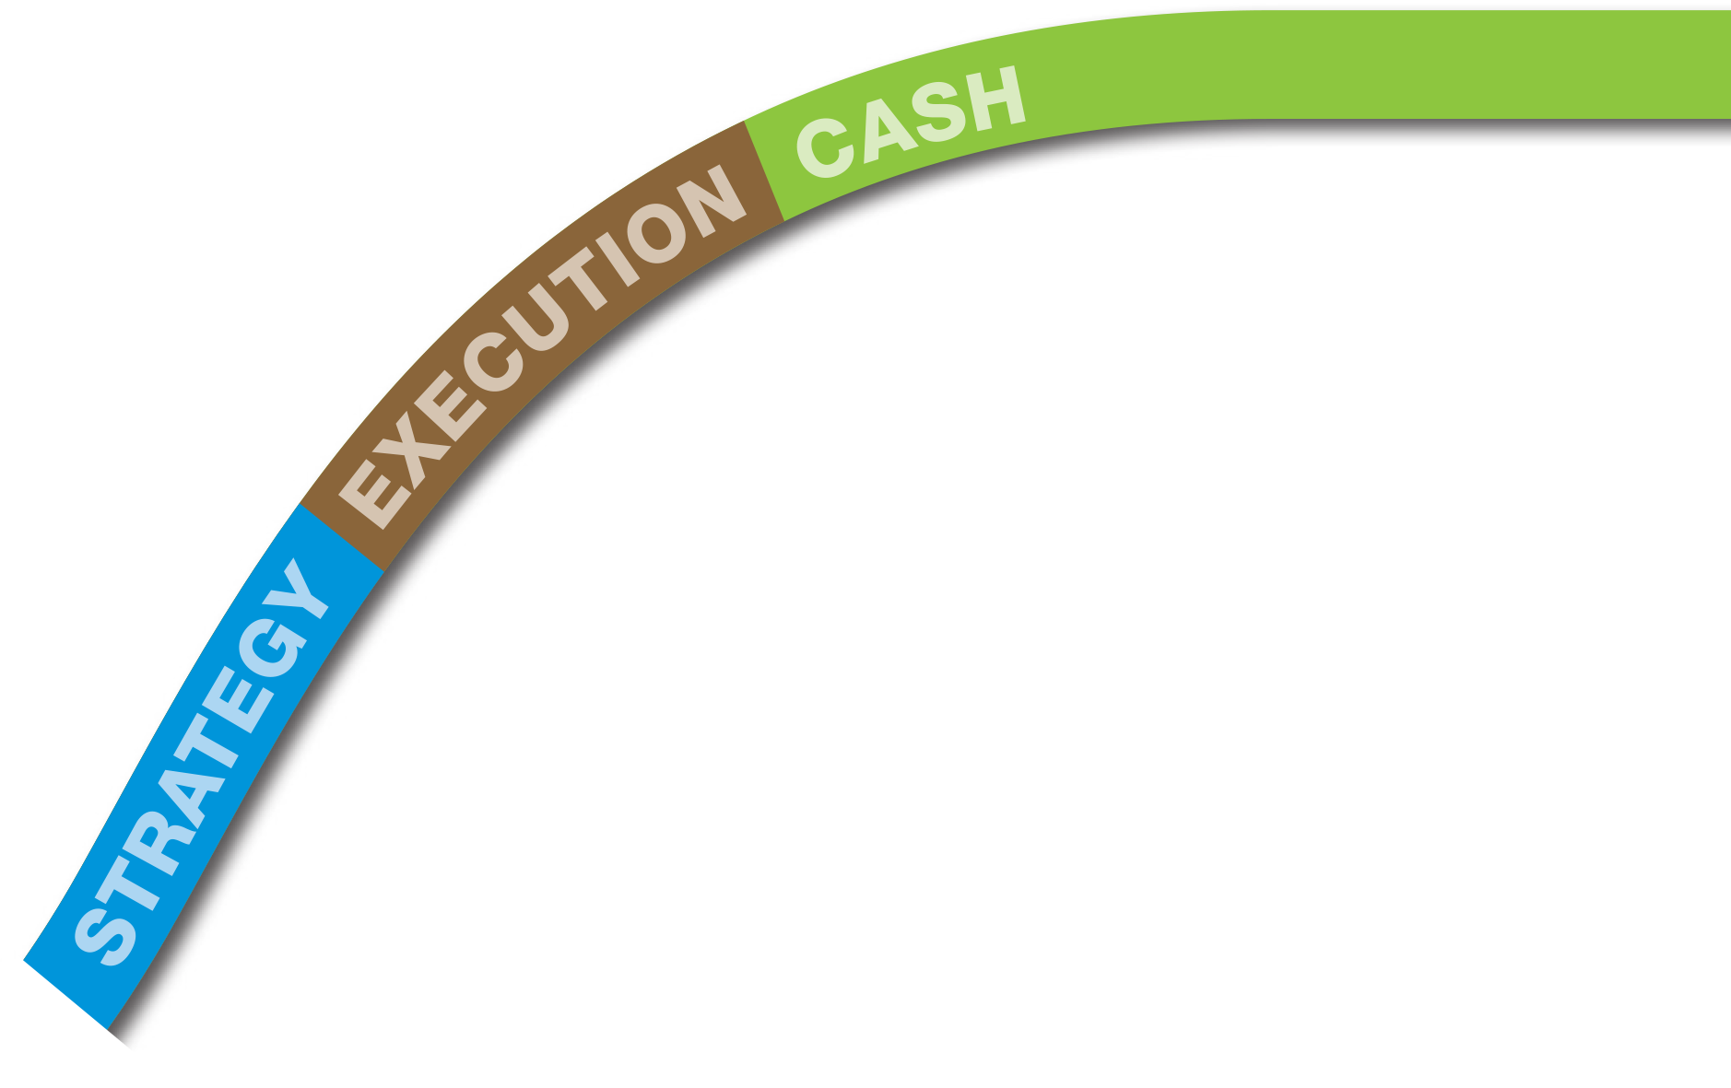
Agile ScaleUp
Lean Startup
Notes:
Blank

Slide 11
4 Decisions
PEOPLE
STRATEGY
EXECUTION
(Happiness)
(Revenue/
Growth)
(Profit/Time)
CASH
(Oxygen/Options)

Slide 12
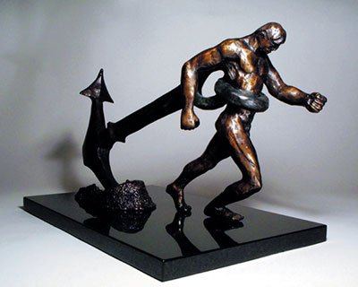

Slide 13
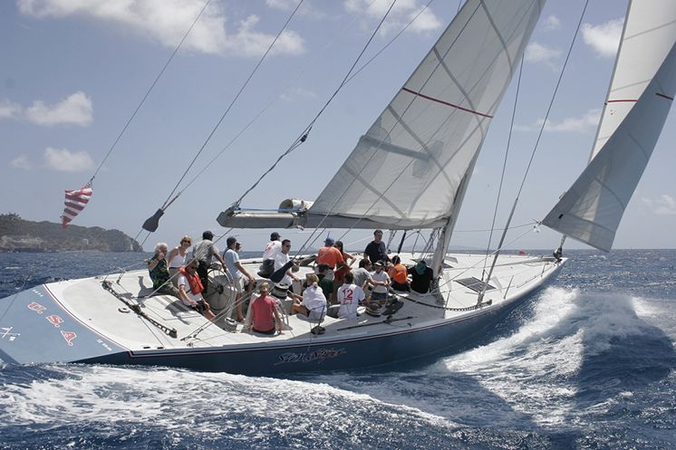

Slide 14
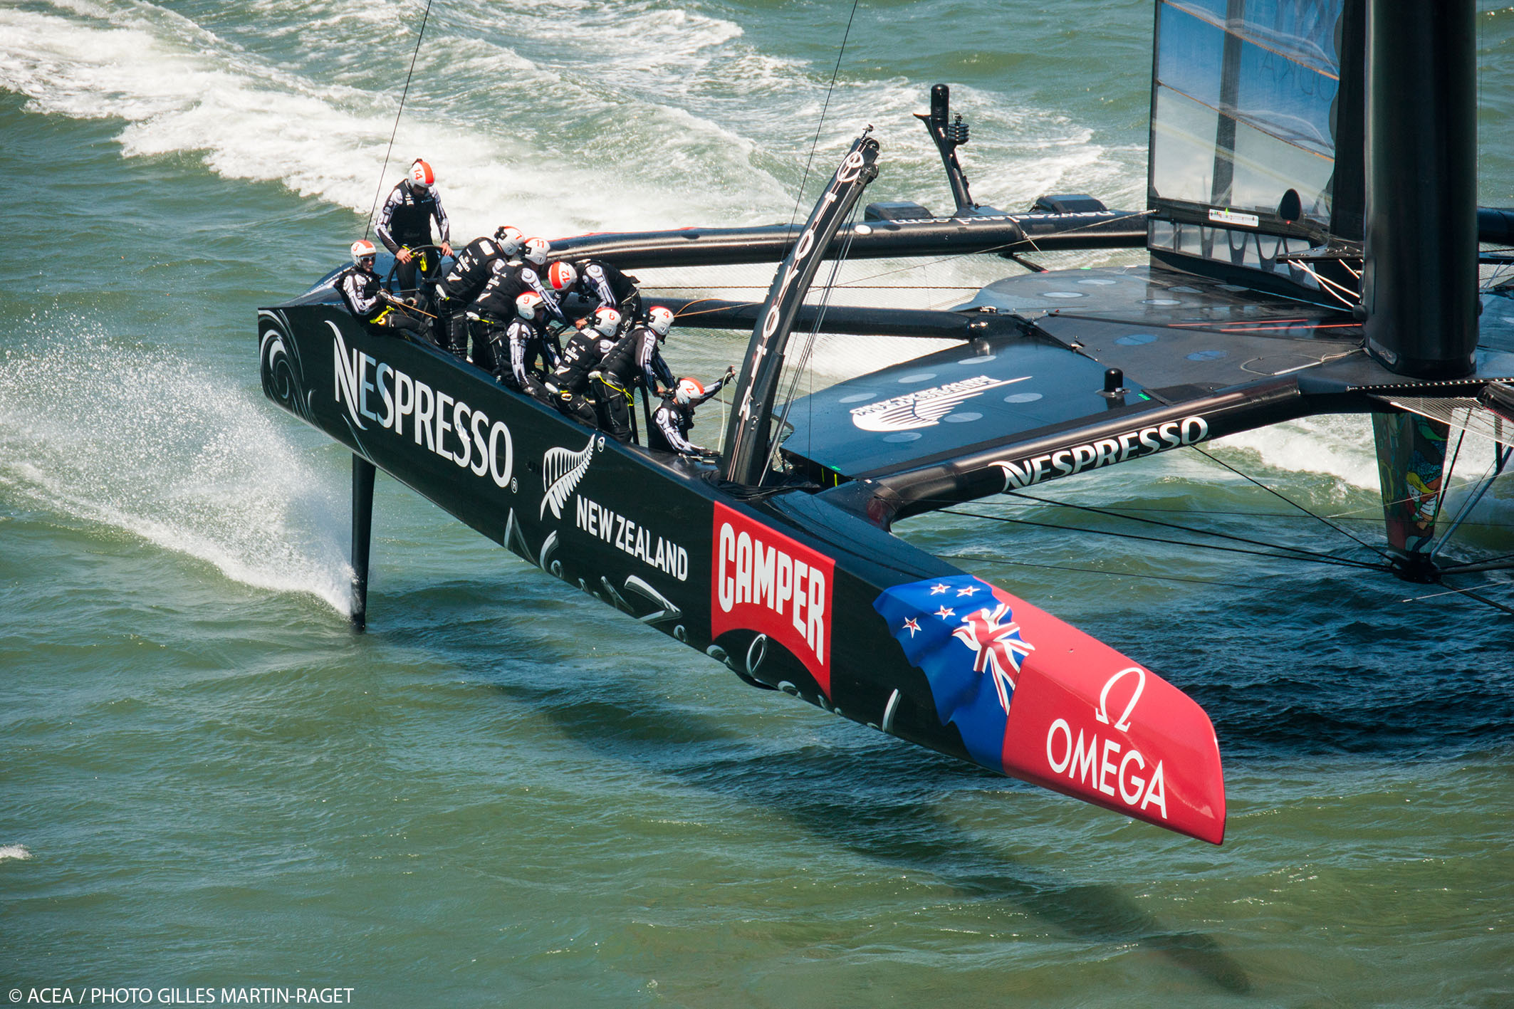

Slide 15
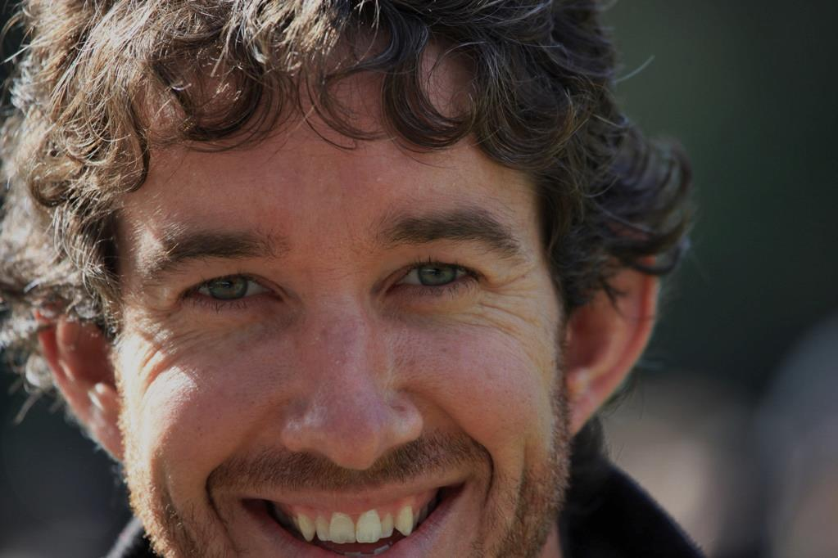
Scaling up a significant business requires precisely the kind of discipline and focus detailed in Verne’s practical and “how-to” driven book.
Scott Farquhar Atlassian

Slide 16
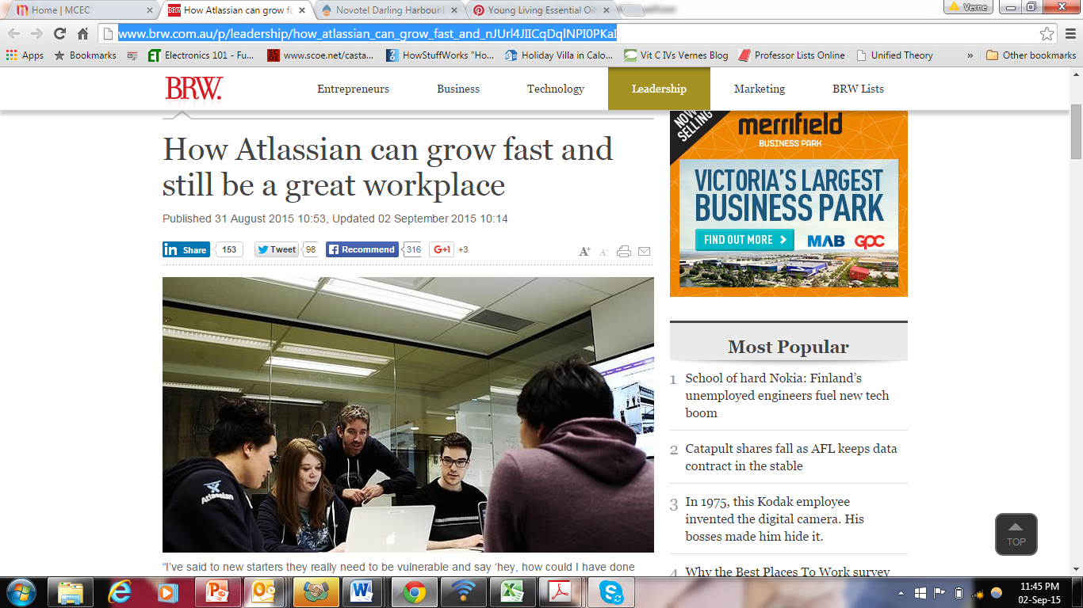

Slide 17
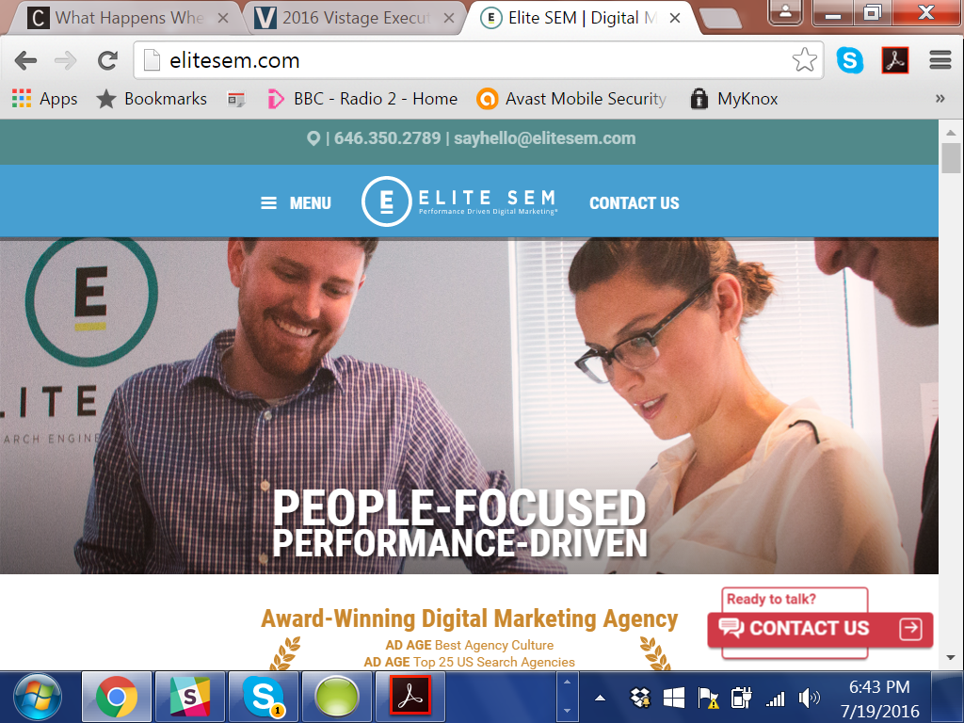

Slide 18
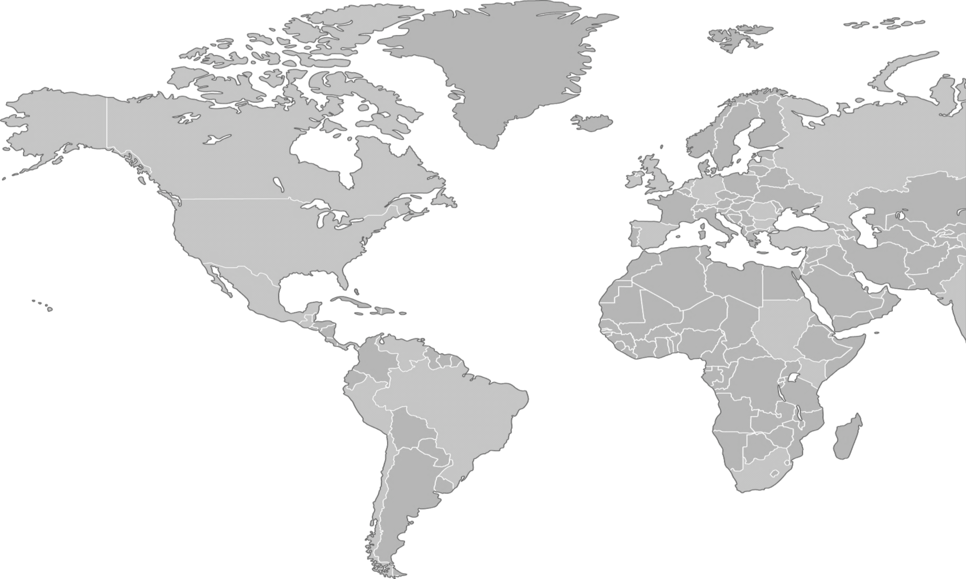
Gazelles
2,000+ Clients
$42.5 Billion
206 Partners Worldwide

Slide 19
Notes:
Portrait slide to introduce a person. To keep the consistency turn it into b/w and if possible maske the person (extract from background). Foto and text can also switch place.

Slide 20
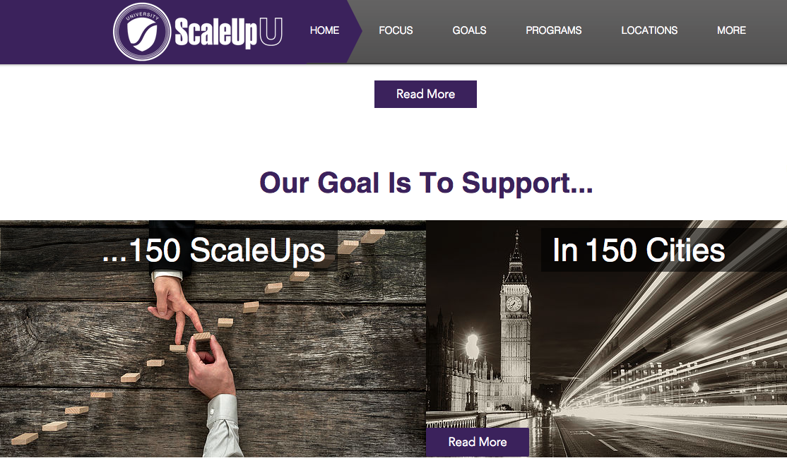
22,000+ Impact

Slide 21
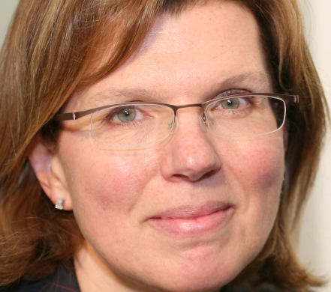
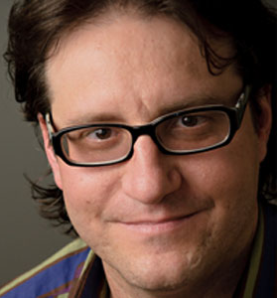
Sherry Coutu
Brad Feld
Tom Stewart

Slide 22
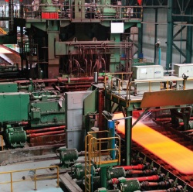
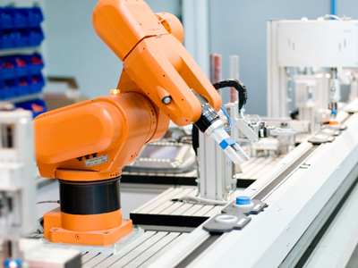
THE MIGHTY MIDDLE MARKET
2 0 0 , 0 0 0
BUSINESSES
60% OF JOB GROWTH
THE UNSUNG HEROES
OF AMERICAN BUSINESS
3% OF ALL U.S. COMPANIES
1/3 OF PRIVATE GDP
1/3 OF PRIVATE EMPLOYMENT
AND
NEW JOBS
IN 2015
Source: 3Q’16 Middle Market Indicator Report

Slide 23
Gazelles – High Impact Firms
High-impact firms are relatively old, rare and contribute to the majority of overall economic growth. On average, they are 25 years old, they represent between 2 and 3 percent of all firms, and they account for almost all of the private sector employment and revenue growth in the economy.

Slide 24
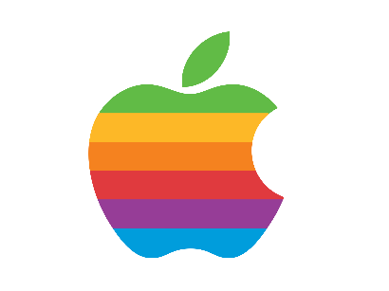
110,000
Apple Employees
after 25 years
9600
0

Slide 25
Starbucks Employees
238,000
after 25 years
16,000
0

Slide 26
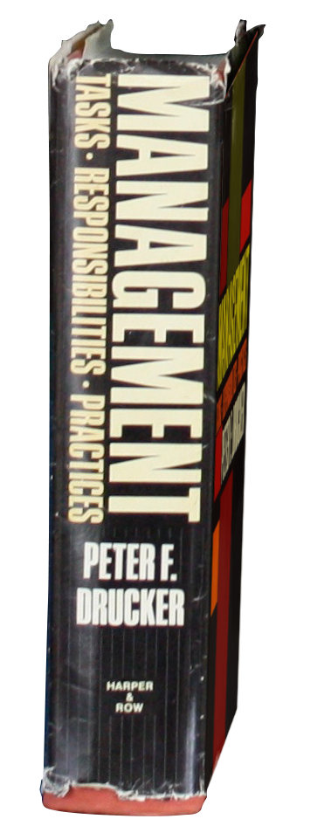
1/3
2/3

Slide 27
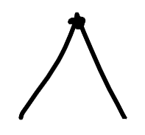
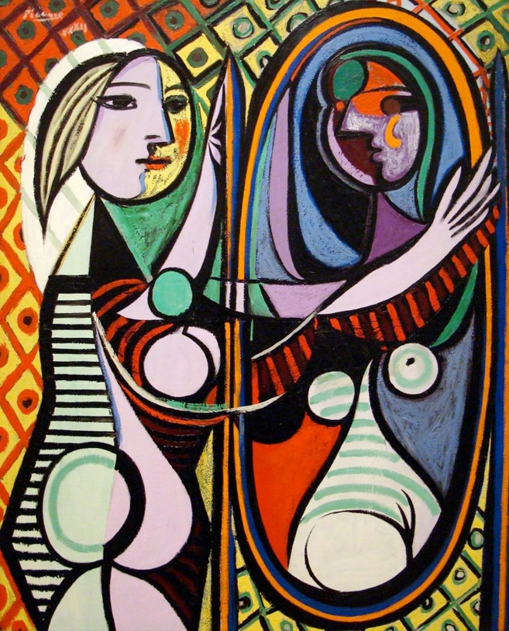
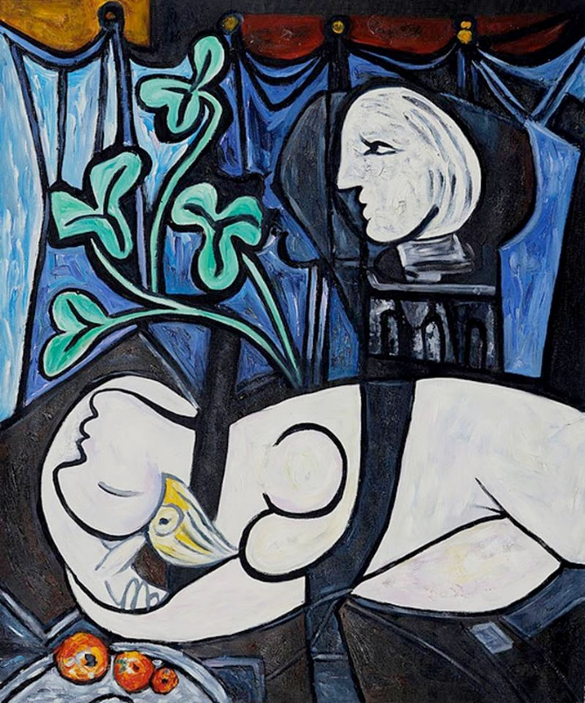
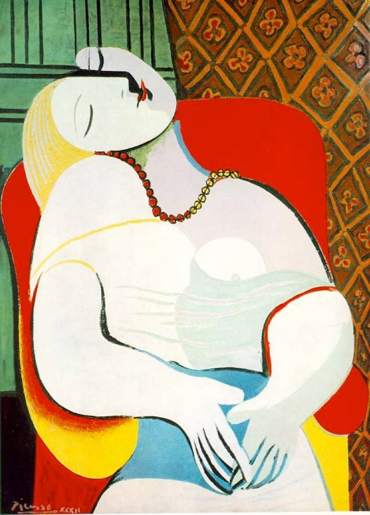
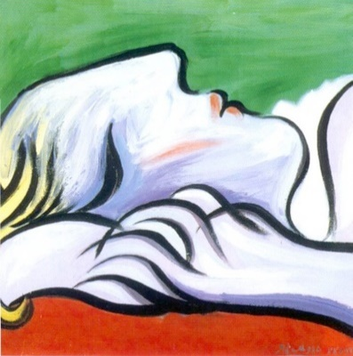
Age 51

Slide 28
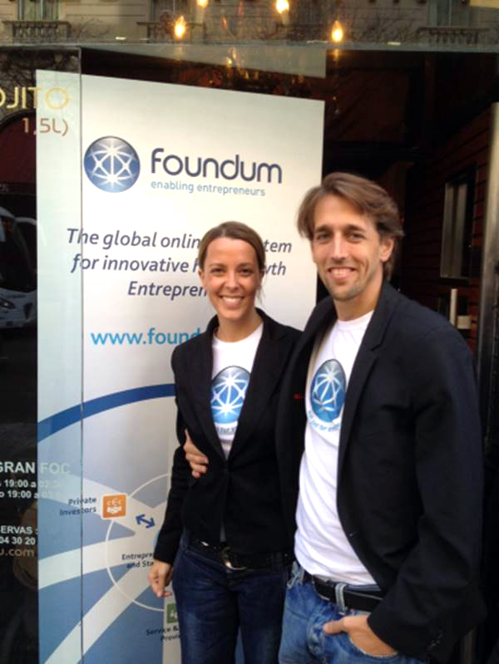
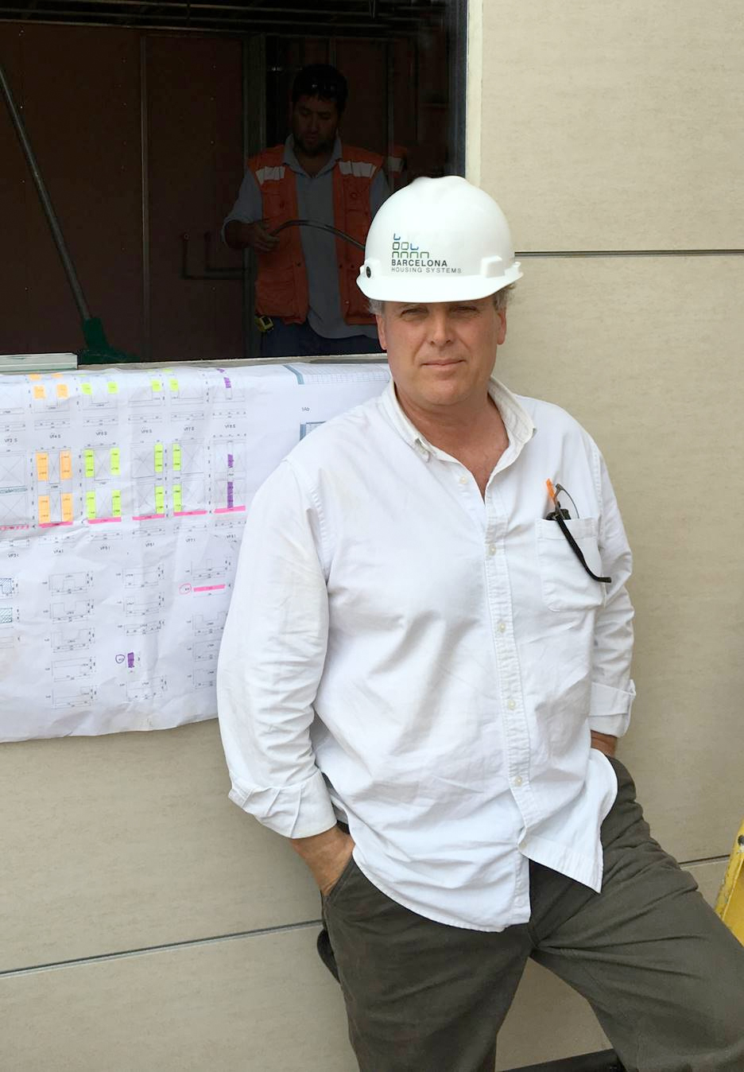

Slide 30
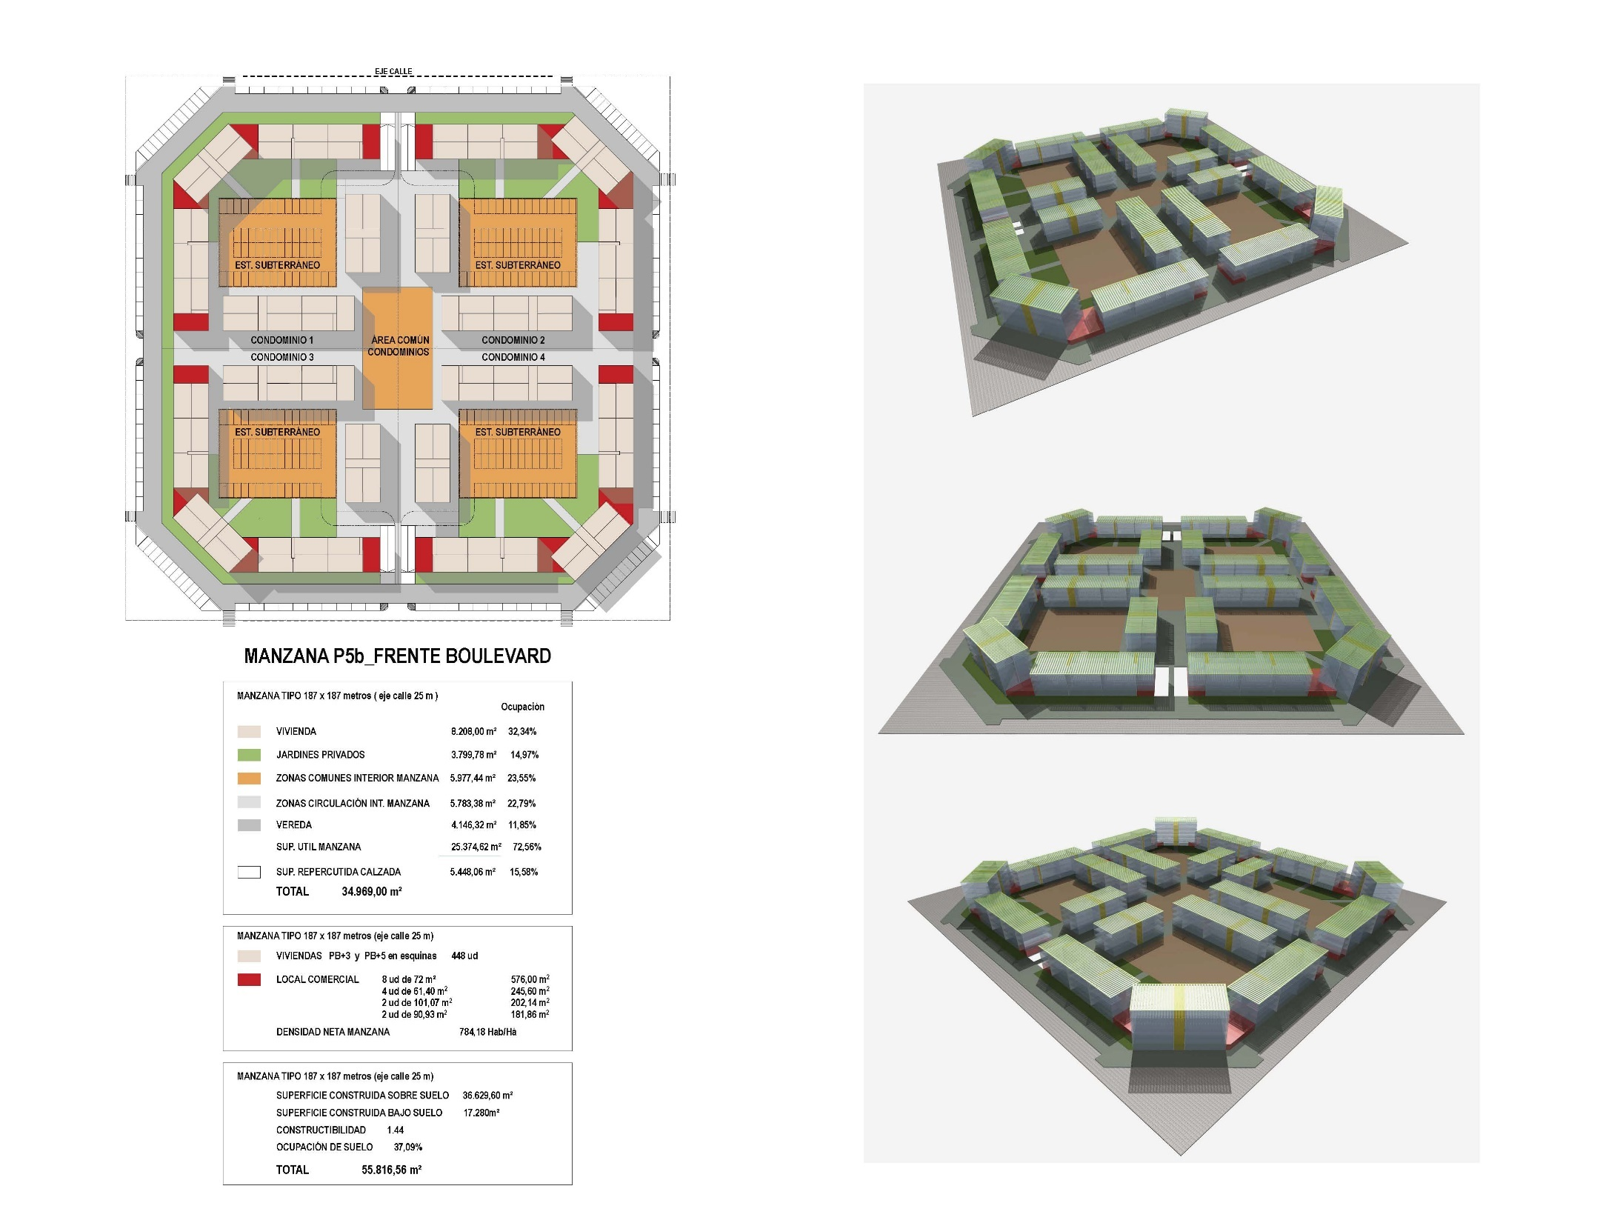

Slide 34
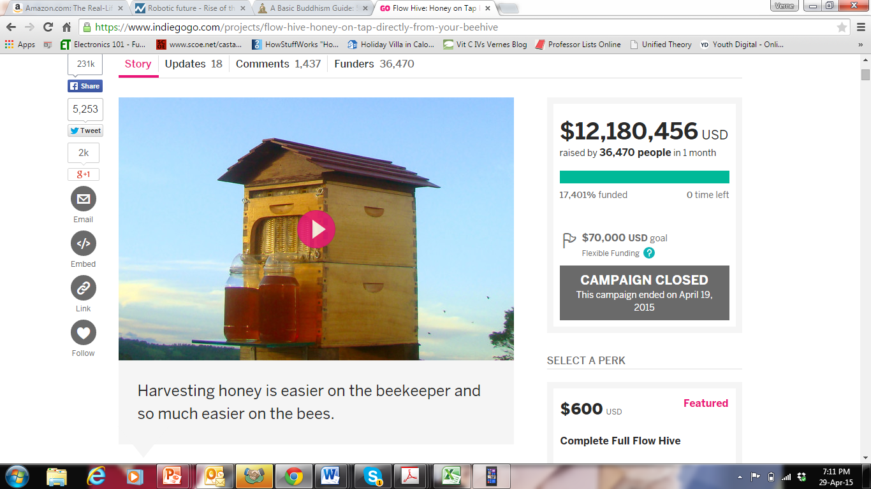

Slide 35
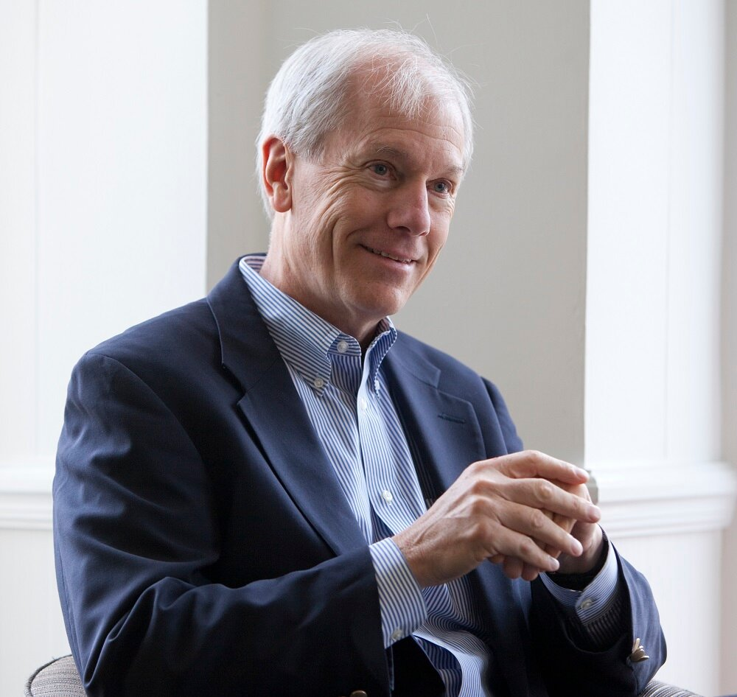
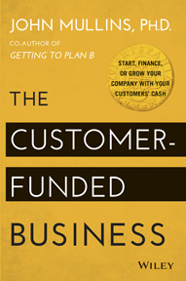
Customer Funded

Slide 36
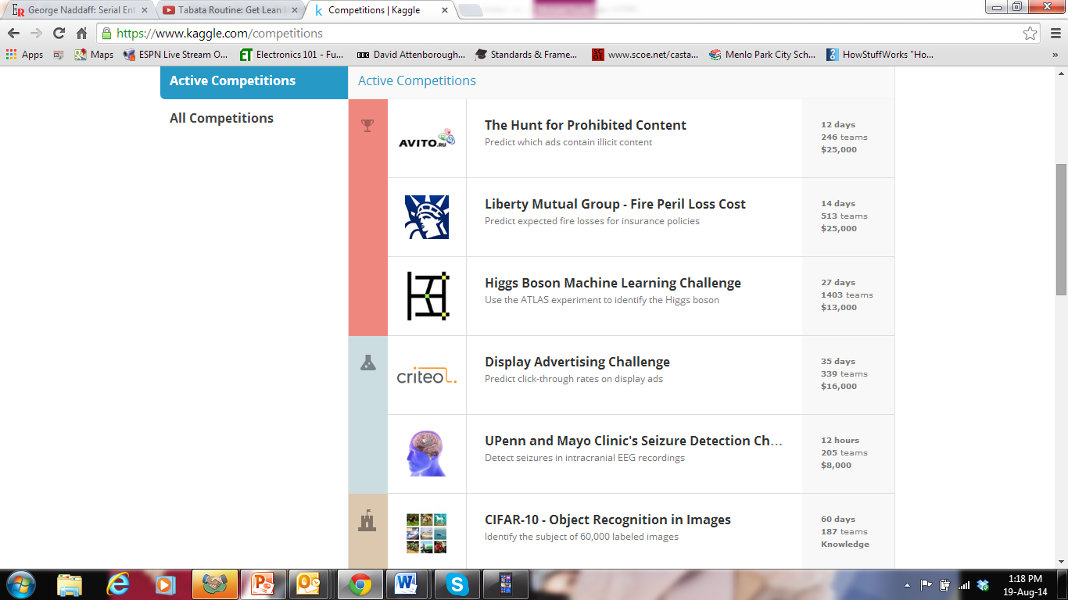
Kaggle.com
Notes:
A dapper Canadian in his mid-fifties, Rob McEwen bought the disparate collection of gold mining companies known as Goldcorp in 1989. A decade later, he’d unified those companies and was ready for expansion—a process he wanted to start by building a new refinery. To determine exactly what size refinery to build, McEwen took the logical step of asking his geologists and engineers how much gold was hidden in his mine. No one knew. He was employing the very best people he could hire, yet none of them could answer his question.
About the same time, while attending an executive program at MIT’s Sloan School of Management, McEwen heard about Linux. This open- source computer operating system got its start in 1991, when Linus Torvalds, then a twenty-one-year-old student at the University of Helsinki, Finland, posted a short message on Usenet:
I’m doing a (free) operating system (just a hobby, won’t be big and professional like gnu) for 386(486) AT clones. This has been brewing since April, and is starting to get ready. I’d like any feedback on things people like/ dislike in minix…
So many people responded to his post that the first version of that operating system was completed in just three years. Linux 1.0 was made publicly available in March 1994, but this wasn’t the end of the project. Afterward, support kept pouring in. And pouring in. In 2006 a study funded by the European Union put the redevelopment cost of Linux version 2.6.8 at $1.14 billion. By 2008, the revenue of all servers, desktops, and software packages running on Linux was $35.7 billion.
McEwen was astounded by all this. Linux has over ten thousand lines of code. He couldn’t believe that hundreds of programmers could collaborate on a system so complex. He couldn’t believe that most would do it for free. He returned to Goldcorp’s offices with a wild idea: rather than ask his own engineers to estimate the amount of gold he had underground, he would take his company’s most prized asset—the geological data normally locked in the safe—and make it freely available to the public. He also decided to incentivize the effort, trying to see if he could get Torvald’s results in a com- pressed time period. In March 2000 McEwen announced the Goldcorp Challenge: “Show me where I can find the next six million ounces of gold, and I will pay you five hundred thousand dollars.”
Over the next few months, Goldcorp received over 1,400 requests for its 400 megabytes of geological data. Ultimately, 125 teams entered the competition. A year later, it was over. Three teams were declared winners. Two were from New Zealand, one was from Russia. None had ever visited McEwen’s mine. Yet so good had the tools of cooperation become and so ripe was our willingness to use them that by 2001, the gold pinpointed by these teams (at a cost of $500,000) was worth billions of dollars on the open market.

Slide 38
Keep Scaling!
Passion, Purpose, and Persistence

